Slide 1
Vehicle Preparedness
PREPAREDNESS UNIVERSITY
Are You READY?
cc-ema.org

Slide 2
Overview
Introduction
Types of Emergencies Requiring Vehicle Preparedness
Essential Items for a Vehicle Emergency Kit
Seasonal Adjustments for Vehicle Preparedness
Fuel & Maintenance Considerations
Communication & Navigation
Evacuation Readiness
Special Considerations
Final Tips & Takeaways

Slide 3
Preparedness: Your Personal Insurance Policy
Preparedness is like an insurance policy you take out on yourself and your household. The coverage and deductible are entirely up to you. Every decision you make about preparedness is an investment in your ability to navigate crises.
Bare Minimum Policy (Liability-Only Coverage)
Covers only the most common, short-duration emergencies (hours - days).
Focus on immediate needs: food, water, flashlight, basic first aid.
Low investment, but limited protection.

Slide 4
Preparedness: Your Personal Insurance Policy
Preparedness is like an insurance policy you take out on yourself and your household. The coverage and deductible are entirely up to you. Every decision you make about preparedness is an investment in your ability to navigate crises.
Moderate Coverage Policy (High-Deductible Plan)
Covers a broader range of situations but requires adaptation and resourcefulness (days – weeks).
More self-reliance required, fewer pre-packed solutions.
Medium investment, with flexibility in extending coverage over time.

Slide 5
Preparedness: Your Personal Insurance Policy
Preparedness is like an insurance policy you take out on yourself and your household. The coverage and deductible are entirely up to you. Every decision you make about preparedness is an investment in your ability to navigate crises.
Comprehensive Policy (Full-Coverage Preparedness)
Covers a wide array of emergencies, including long-term disruptions (weeks – months).
Requires more maintenance and periodic updates to keep supplies fresh.
Higher upfront cost but ensures maximum readiness.

Slide 6
Preparedness: Your Personal Insurance Policy
Preparedness is like an insurance policy you take out on yourself and your household. The coverage and deductible are entirely up to you. Every decision you make about preparedness is an investment in your ability to navigate crises.
Applying the Insurance Mindset to Every Lesson
Each class topic is another layer of protection to add to your policy.
Consider what level of preparedness fits your needs and lifestyle.
Reassess your preparedness policy regularly as circumstances change.

Slide 7
Preparedness: Your Personal Insurance Policy
Budget-Conscious Preparedness Approach
Start by identifying existing items around your home that can fill preparedness needs.
Repurpose and reuse older gear before purchasing new equipment.
Gradually acquire additional supplies and capabilities as your budget allows.
Focus on high-priority, cost-effective solutions first, then expand over time.
Preparedness doesn’t have to be expensive—small, consistent improvements lead to long-term resilience.

Slide 8
Introduction
Why Vehicle Preparedness Matters
Emergencies can strike anytime, often when you’re on the road.
A well-prepared vehicle can be a lifeline during disasters.
Ensures mobility, safety, and self-sufficiency in a crisis.

Slide 9
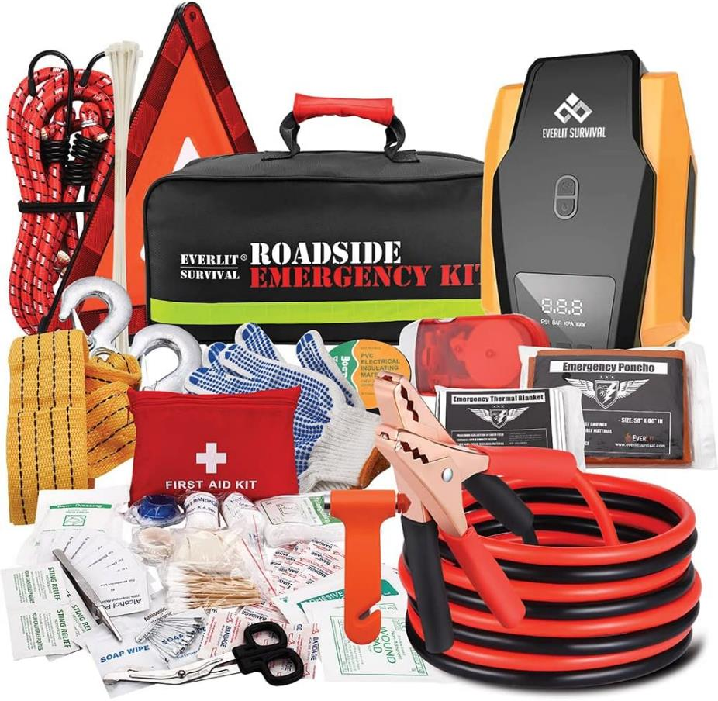
Essential Items for Vehicle Emergency Kit

Slide 10
Essential Items for Vehicle Emergency Kit
Automobile Related Tools:
Work gloves
Jumper cables (or portable jumper)
Tire repair kit & air compressor
Road flares or reflectors (reflective vest)
Fire extinguisher (rated for vehicle use)
Basic toolkit (wrenches, pliers, screwdrivers)
Window breaker and seatbelt cutter

Slide 11
Essential Items for Vehicle Emergency Kit
Basic Supplies:
Water (1 gallon per person, per day)
Non-perishable food/snacks
First aid kit
Flashlight & extra batteries
Multi-tool or Swiss Army knife
Road maps & emergency contact list

Slide 12
Seasonal Adjustments for Vehicle Preparedness
Summer Preparedness:
Extra water supply
Sunshade for windshield
Electrolyte packets or sports drinks

Slide 13
Seasonal Adjustments for Vehicle Preparedness
Winter Preparedness:
Extra hat & gloves
Ice scraper & snow brush
Extra blankets & hand warmers
Sand or cat litter for traction (or traction pads)
Windshield washer fluid rated for freezing temps
Folding shovel

Slide 14
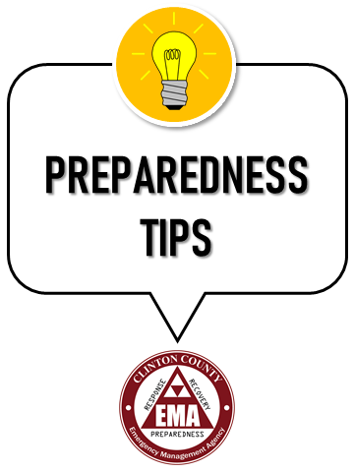
A full tank of gas will keep the fuel line from freezing.
Check Tire Pressure Weekly in Winter – Cold temperatures cause air to contract, lowering tire pressure and affecting handling.
Grease Battery Terminals – A light coating of petroleum jelly prevents corrosion and improves connections.
Store a Solar Phone Charger – If your car battery dies, a solar charger can still keep your phone operational.
Zip-Ties & Duct Tape – Can temporarily secure a bumper, fender, or even a broken hose until you get repairs.
Carry a Candle & Lighter – A single candle inside a metal can (like a coffee tin) can provide enough heat to keep a vehicle interior warm in freezing conditions.

Slide 15
Turn Off Traction Control When Stuck in Snow/Mud – Some traction control systems limit power to spinning wheels, which can prevent movement when trying to rock a car out of a stuck position.
Use a Sleeping Bag Instead of a Blanket – A sleeping bag provides better warmth retention if you are stranded overnight.
Who reads manuals? Put a $20 Bill in Your Car Manual – Useful if you need emergency cash for gas or a tow when card readers are down.
Turn Wheels Toward the Curb When Parking on a Hill – This prevents rolling if brakes fail and makes it harder for thieves to tow the car away.
Store water in a freezer shopping bag to keep from freezing.

Slide 16
Store the seatbelt cutter and window breaker in easy reach (e.g., visor, center console).
Storage a torniquet in easy reach.
Take a Stop-the-Bleed class
(Security) Carry a small personal defense item (if legally permitted).
(Safety) Keep N95 masks or respirators for wildfire smoke, dust storms, or chemical spills.

Slide 17
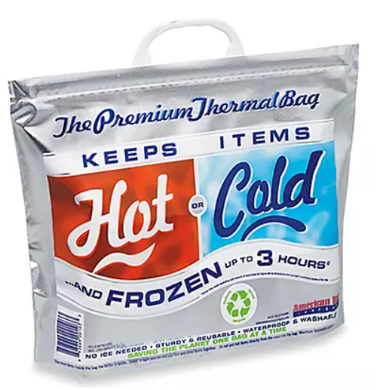
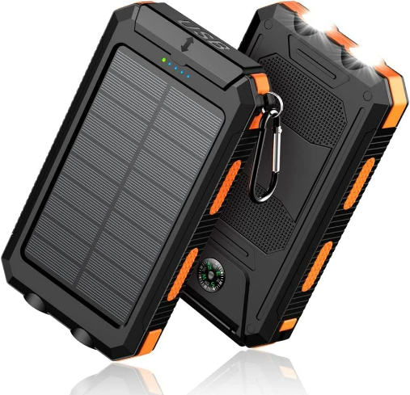
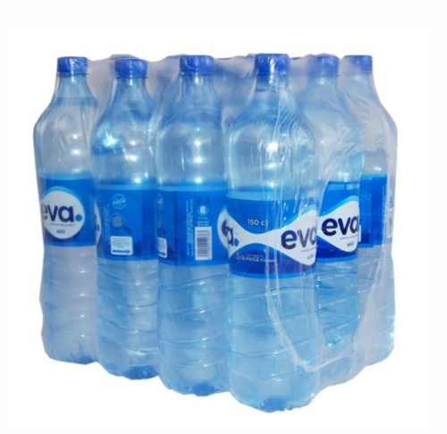

Slide 18
Fuel & Maintenance Considerations
Keep gas tank at least half full at all times.
Store extra fuel safely (if applicable and legal in your area).
Regularly check fluids (oil, coolant, brake, transmission).
Maintain tire pressure and tread depth.
Ensure battery is in good condition.
Test emergency lights and signals frequently.

Slide 19
Communication & Navigation
Mobile phone & charger
Backup Options: Two-way radios, satellite phone (for remote areas)
Separate course on emergency communications
Navigation: GPS device, offline maps, printed road atlas
Emergency Contact Plan: Share route plans with family or friends

Slide 20
Evacuation Readiness
Keep vehicle accessible and ready to go during emergencies.
Pack a go-bag with essentials.
Identify multiple evacuation routes.
Know local emergency shelter locations.
Monitor emergency alerts and road conditions.

Slide 21
Special Considerations
For Medical Needs:
Ensure extra meds & medical equipment are in the vehicle (know temp limits / insulated bag).
For Pets:
Keep pet food, water, leash, and travel carrier ready.
For Families:
Car seats should be installed properly.
Pack extra child supplies (diapers, formula*, entertainment items).

Slide 22
Special Considerations
Short-Term Formula Storage for Vehicles:
Max short-term exposure: A few hours in mod. temps, but no more than 1-2 hours >85°F.
Avoid heat & freezing – Cars can exceed 120°F in summer or drop below freezing in winter, spoiling formula.
Use an insulated cooler – Ice packs in heat, thermal bags in cold.
Prefer powdered over liquid – Less perishable but still needs dry, stable temps.
Rotate & inspect – Check expiration dates and for changes in smell or texture.
Discard if frozen or overheated – Can lose nutrients and separate improperly.

Slide 23
Final Tips & Takeaways
Regularly inspect and update vehicle emergency supplies.
Practice emergency plans with family members.
Stay informed about local hazards and road conditions.
Maintain vehicle preparedness as part of overall disaster readiness.

Slide 24
Questions & Discussion

Slide 25
Homework
Assemble & Inspect Your Vehicle Kit
Gather essential emergency items (jumper cables, first aid kit, flashlight, water, food, etc.).
Check vehicle fluids, tire pressure, battery, and emergency lights.
Plan for Seasonal & Emergency Adjustments
Add winter/summer-specific items (blankets, ice scraper, extra water, sunshade, etc.).
Identify backup communication tools and download offline maps.

Slide 26
Homework
Practice an Emergency Scenario
Run a drill simulating a breakdown or evacuation.
Review emergency routes and alternate paths.
Secure Important Documents & Safety Items
Store copies of registration, insurance, and emergency cash.
Take a first aid or Stop-the-Bleed course and add a tourniquet to your kit.

