Slide 1
Preparedness for Apartments & Mobile Homes – Are You READY?
PREPAREDNESS UNIVERSITY
Are You READY?
cc-ema.org

Slide 2
Overview
Your Preparedness Policy
Unique Risks for Apartments & Mobile Homes
Sheltering-in-place vs. evacuation
Evacuation Planning Essentials
Creating a Go Bag
Community Coordination & “Mutual Aid”
Effective Communication & Alerts
Post-Event Safety and Recovery

Slide 3



Preparedness: Your Personal Insurance Policy
Preparedness is like an insurance policy you take out on yourself and your household. The coverage and deductible are entirely up to you. Every decision you make about preparedness is an investment in your ability to navigate crises.
Bare Minimum Policy (Liability-Only Coverage)
  Covers only the most common, short-duration emergencies (hours - days).
  Focus on immediate needs: food, water, flashlight, basic first aid.
  Low investment, but limited protection.

Slide 4
Preparedness: Your Personal Insurance Policy
Preparedness is like an insurance policy you take out on yourself and your household. The coverage and deductible are entirely up to you. Every decision you make about preparedness is an investment in your ability to navigate crises.
Moderate Coverage Policy (High-Deductible Plan)
  Covers a broader range of situations but requires adaptation and resourcefulness (days – weeks).
  More self-reliance required, fewer pre-packed solutions.
  Medium investment, with flexibility in extending coverage over time.

Slide 5
Preparedness: Your Personal Insurance Policy
Preparedness is like an insurance policy you take out on yourself and your household. The coverage and deductible are entirely up to you. Every decision you make about preparedness is an investment in your ability to navigate crises.
Comprehensive Policy (Full-Coverage Preparedness)
  Covers a wide array of emergencies, including long-term disruptions (weeks – months).
  Requires more maintenance and periodic updates to keep supplies fresh.
  Higher upfront cost but ensures maximum readiness.

Slide 6
Preparedness: Your Personal Insurance Policy
Preparedness is like an insurance policy you take out on yourself and your household. The coverage and deductible are entirely up to you. Every decision you make about preparedness is an investment in your ability to navigate crises.
Applying the Insurance Mindset to Every Lesson
  Each class topic is another layer of protection to add to your policy.
  Consider what level of preparedness fits your needs and lifestyle.
  Reassess your preparedness policy regularly as circumstances change.

Slide 7
Preparedness: Your Personal Insurance Policy
Budget-Conscious Preparedness Approach
  Start by identifying existing items around your home that can fill preparedness needs.
  Repurpose and reuse older gear before purchasing new equipment.
  Gradually acquire additional supplies and capabilities as your budget allows.
  Focus on high-priority, cost-effective solutions first, then expand over time.
  Preparedness doesn’t have to be expensive—small, consistent improvements lead to long-term resilience.

Slide 8
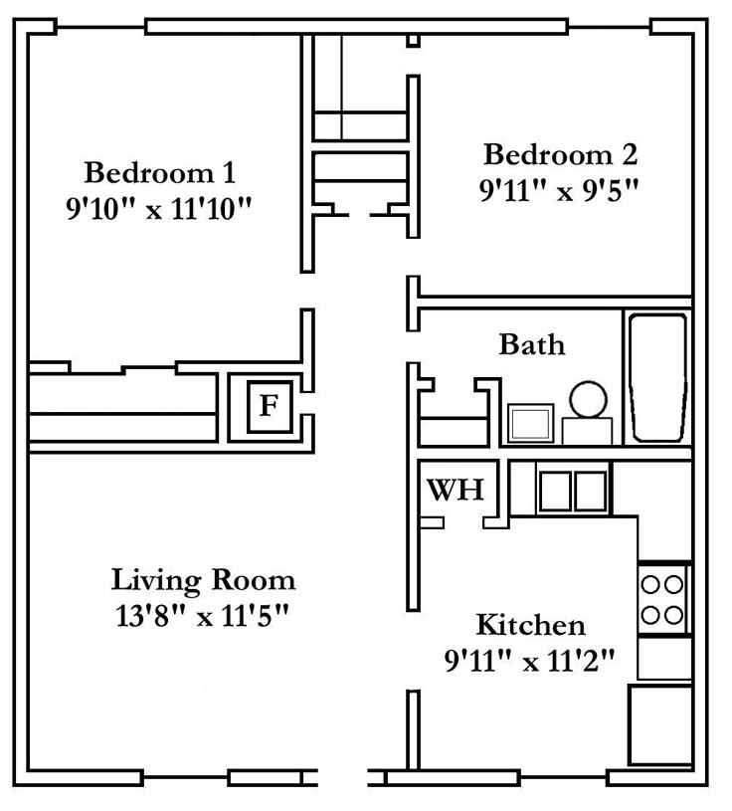
Unique Vulnerabilities
Apartments:
Limited personal storage space
Shared walls and utilities
Evacuation bottlenecks

Slide 9
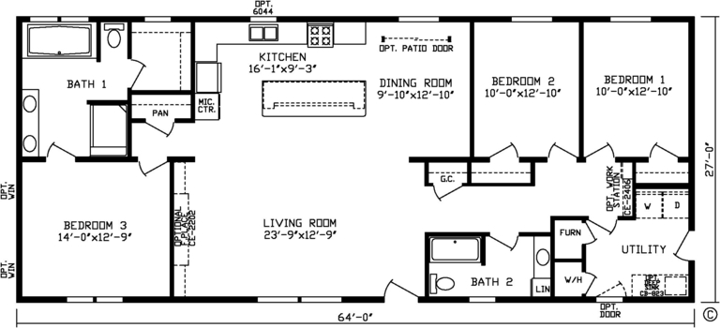
Unique Vulnerabilities
Mobile Homes:
Structural vulnerabilities in severe weather
Limited sheltering options
Isolated or rural locations

Slide 10
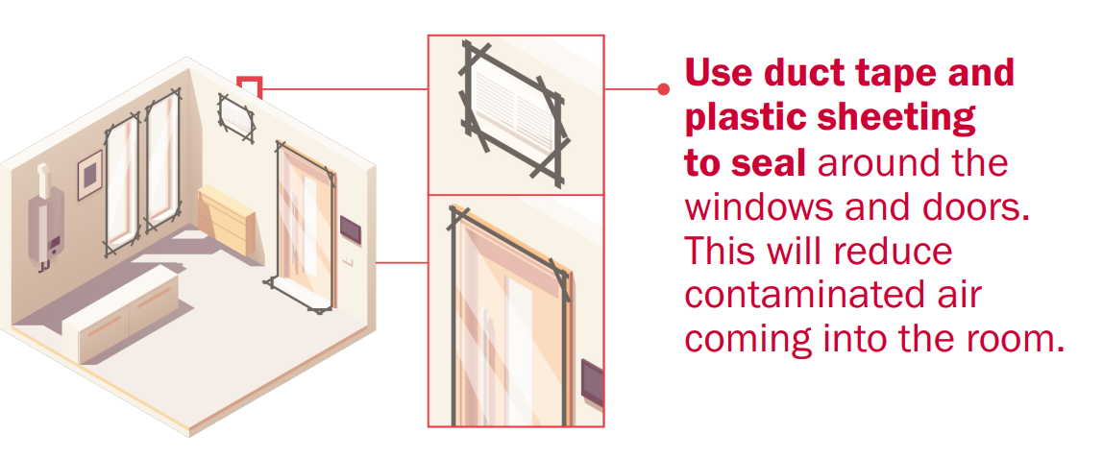
Sheltering-In-Place (SIP) Considerations
When sheltering is appropriate (chemical spills, storms, power outages)
Safe locations (interior rooms, *basements, reinforced areas)
Managing utilities safely (gas, electricity, water)

Slide 11
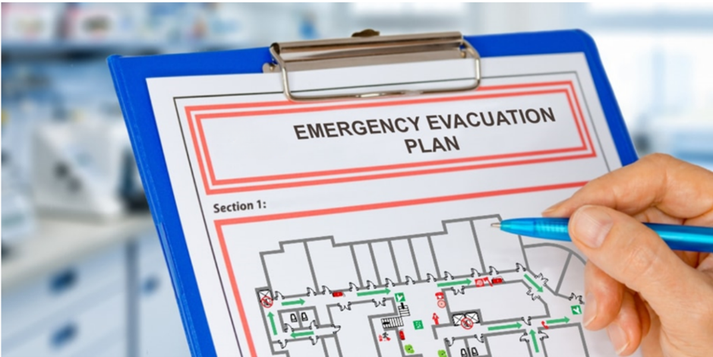
Evacuation Planning Essentials
Recognizing evacuation signals (sirens, local alerts)
Apartment evacuation routes (stairs, hallways, exits)
Mobile home evacuation routes (pre-identified safe locations, storm shelters)

Slide 12
Evacuation Planning Essentials
What could force you to evacuate your home?
What would you take?

Slide 13
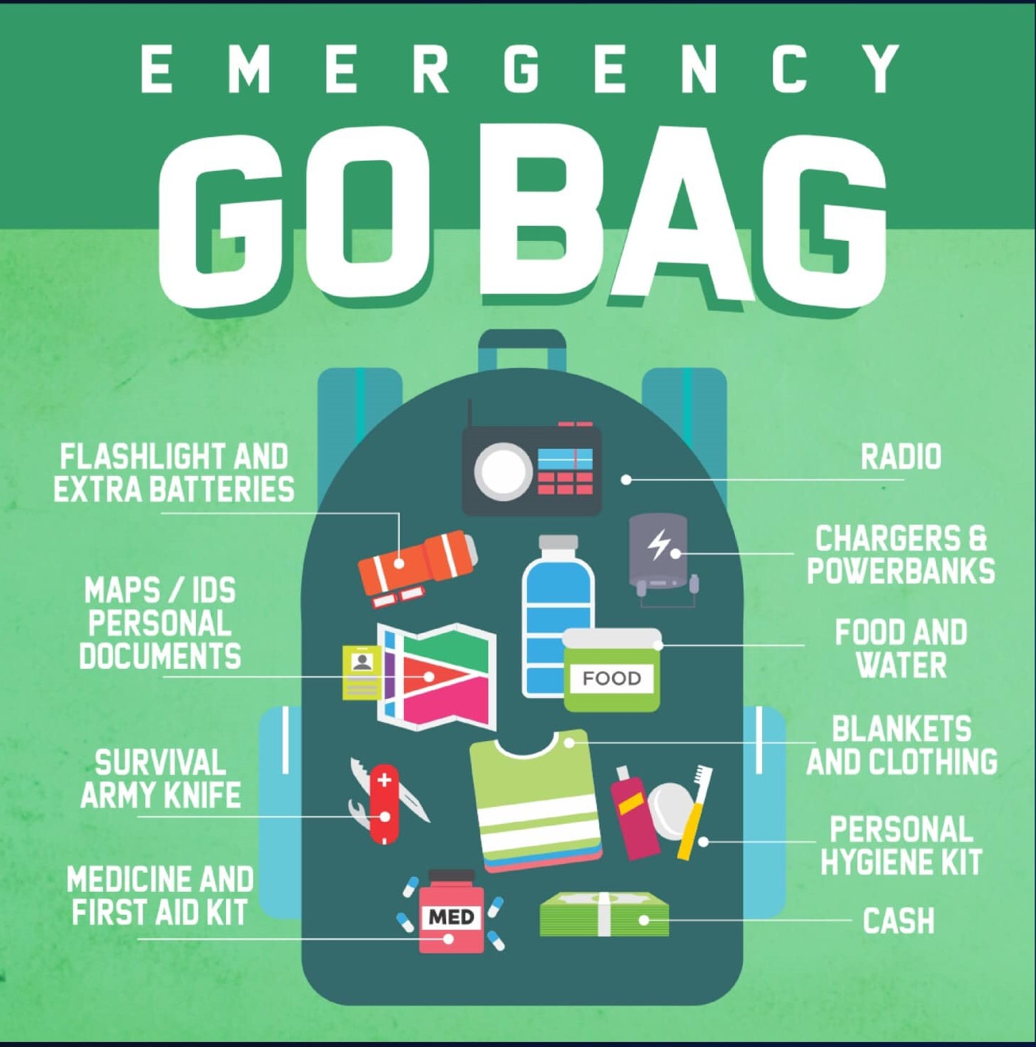
Creating a Go Bag
A Go Bag gives residents a compact, ready-to-carry kit that ensures they can evacuate quickly with essential items. It provides speed, security, and self-sufficiency during emergencies when time and storage are limited.
Essential items (documents, medication, water, food, flashlights)
Considerations for apartment/mobile home residents:
  Portability
  Limited storage

Slide 14
IMPORTANT DOCUMENTS
(stored in waterproof pouch)
Copies of ID(s)
Insurance Papers
Copy of Lease or Rental Agreement
Medical Information
Emergency Contacts
ESSENTIAL ITEMS
Water
Food
First Aid/Medical
Flashlight & Batteries
Multi-Tool or Utility Knife
Personal Hygiene Items
Whistle
CLOTHING & COMFORT
Change of clothes (seasonal)
Small blanket or emergency mylar space blanket
Study shoes (if not worn daily)
COMMS & SAFETY
Portable phone charger / power bank
Battery-powered or hand-crank radio
N95 or dust mask
Gloves (work or lightweight)
MONEY & EXTRAS
Emergency Cash (small bills)
Spare glasses or contacts
Notebook and pen
SPECIAL CONSIDERATIONS
Infant/Child Needs
Pet Supplies
Spare keys

Slide 15
Essential Items for a Bug-Out Bag
Who Should Have a Bug-Out Bag?
Every household should have one bag per person tailored to specific needs (children, elderly, pets).
Keep BoBs accessible in vehicles, near home exits, or emergency storage areas.

Slide 16
Essential Items for a Get-Home Bag
A GHB should be compact but effective in helping you travel on foot 10-30 miles if needed.
Water & Purification: 1 liter of water, purification tablets
Food: Energy bars, jerky, electrolyte packets
Clothing: Comfortable walking shoes, spare socks, gloves, hat
First Aid: Small trauma kit, bandages, antiseptic wipes
Navigation: Paper map of local area, compass

Slide 17
Essential Items for a Get-Home Bag
A GHB should be compact but effective in helping you travel on foot 10-30 miles if needed.
Self-Defense: Pepper spray or self-defense tool (as legally permitted)
Safety Items: Dust mask, goggles (for debris, smoke protection)
Lighting: Compact flashlight or headlamp
Multitool: Small knife, paracord, duct tape
Emergency Contacts: Printed list, emergency whistle

Slide 18
Essential Items for a Get-Home Bag
Additional Items to Consider:
Small Folding Stove & Fuel Tabs (for boiling water, cooking)
Spare Phone Battery Pack
HAM or GMRS Radio (for emergency comms)
Solar charger/power
Cash in Small Bills (ATMs may be down)

Slide 19
Essential Items for a Get-Home Bag
Seasonal Adjustments:
Winter: Hand warmers, insulated gloves, extra layers
Summer: Sunscreen, extra water, cooling towel
Rainy Season: Waterproof bag, poncho

Slide 20
Real-World Case Studies: Lessons from Disasters
East Palestine Train Derailment (2023)
Residents forced to evacuate due to hazardous chemical exposure.
Those with a Bug-Out Bag could leave immediately with essential supplies.
Shelters were overwhelmed, and personal hygiene items were critical.

Slide 21
Real-World Case Studies: Lessons from Disasters
California Wildfires
Sudden evacuation orders meant minutes to leave before fire spread.
Smoke and ash made respiratory protection (N95 masks, goggles) essential.
Those with pre-packed Bug-Out Bags had a major advantage in securing shelter quickly.

Slide 22
Final BOB / GHB Takeaways
Know the Difference: A Bug-Out Bag is for evacuation, a Get-Home Bag is for returning home.
Tailor Your Bag: Customize contents based on personal needs and environment.
Regularly Update Gear: Rotate food, water, batteries, and seasonal items.
Have a Plan: Know when to evacuate, where to go, and how to communicate.

Slide 23
Community Coordination & Mutual Aid
Benefits of coordinating preparedness with neighbors
Creating emergency resource pools
Establishing neighborhood preparedness teams

Slide 24
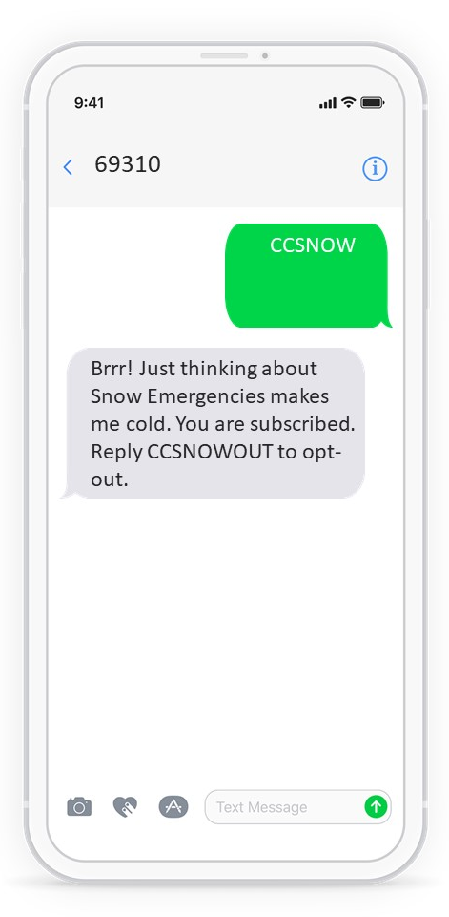
Effective Communication & Alerts
Signing up for local emergency notifications
Establishing alternate community communication (radio, social media)
Using community bulletin boards effectively

Slide 25
Post-Incident Safety & Recovery
Safe re-entry after evacuation
Conducting quick damage assessment
  Take Photos!
  Hazards
  DA for Insurance
  DA for Disaster Declaration
Connecting with recovery resources (FEMA, Red Cross, Insurance)

Slide 26
Practical Checklists - Apartment
Identify safest interior room (away from windows/doors).
Keep a compact Go Bag ready with essentials.
Store water in smaller containers (easier to move).
Maintain a fire extinguisher and know evacuation routes.
Secure important documents in a waterproof pouch.
Sign up for local emergency alerts.

Slide 27
Practical Checklists – Mobile Home
Pre-identify nearest community storm shelter.
Keep transportation options ready for quick evacuation.
Reinforce skirting, tie-downs, and entry steps.
Maintain Go Bag with portable essentials.
Store extra fuel, water, and a weather radio.
Know alternate routes out of the community.

Slide 28
Practical Checklists – Community Coordination
Organize a resident safety group or buddy system.
Share contact info with trusted neighbors.
Pool resources (tools, first aid, backup power).Post evacuation maps in community areas.
Hold periodic preparedness meetings or drills.
Establish a communication method (group text, radios, bulletin board).

Slide 29
Summary
Your Preparedness Policy
Unique Risks for Apartments & Mobile Homes
Sheltering-in-place vs. evacuation
Evacuation Planning Essentials
Creating a Go Bag
Community Coordination & “Mutual Aid”
Effective Communication & Alerts
Post-Event Safety and Recovery

Slide 30
Questions & Discussion

